Slide 1
Honouring Stories
Art Project

Slide 2
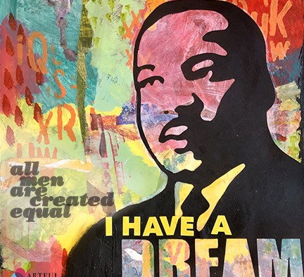
Goal
Create a portrait on canvas that honours the person and their story.

Slide 4
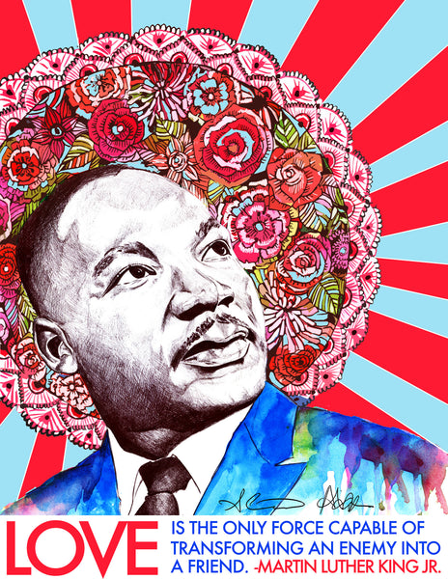

Slide 7
Steps
1. Create a black and white portrait on paper
2. Paint the background of your canvas
3. Mod podge your portrait on top of your canvas

Slide 8
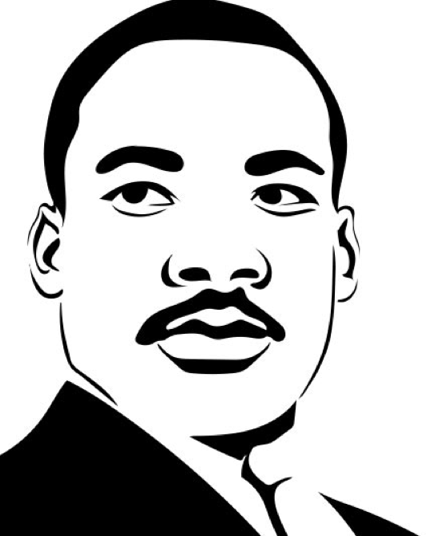
Step 1 – Create your Portrait
Black and white
On PAPER
Pencil crayons and/or markers

Slide 9
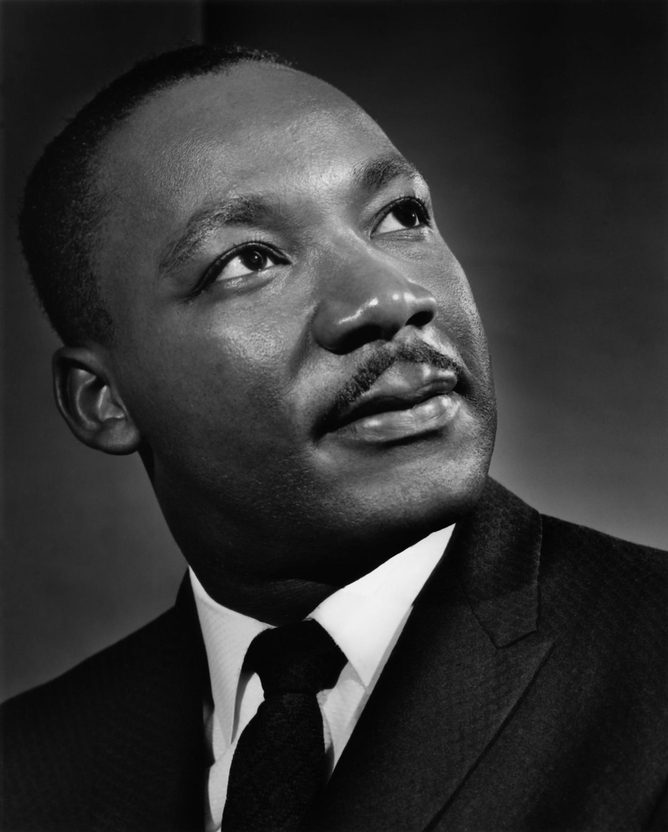
Find a picture
Find a good portrait of the person you are researching
Print the image so it takes up as much of the page as possible

Slide 10
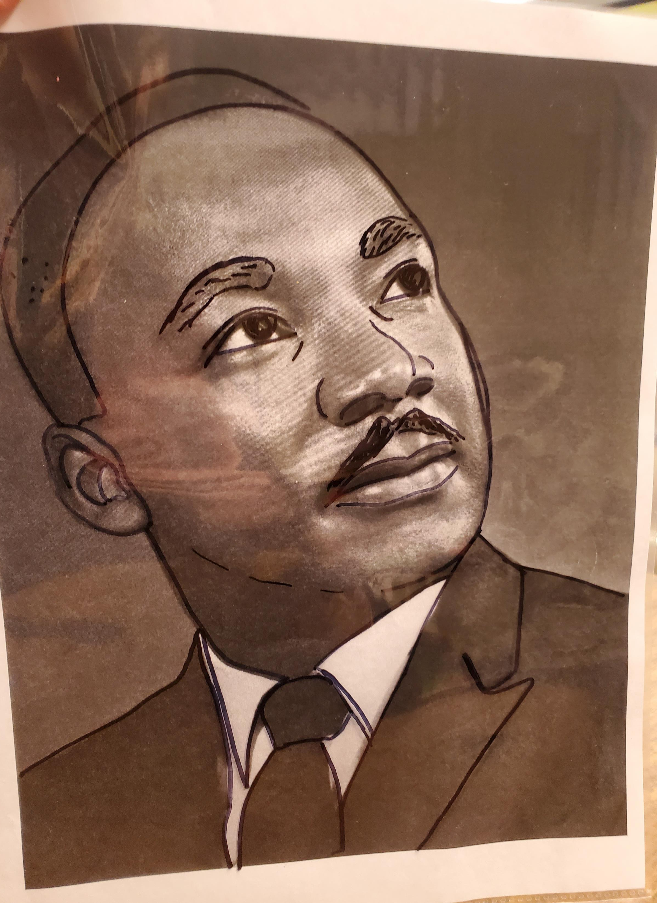
Trace
Use a permanent marker
Place picture into a page protector
Trace ONLY the most important lines on the person’s face

Slide 11
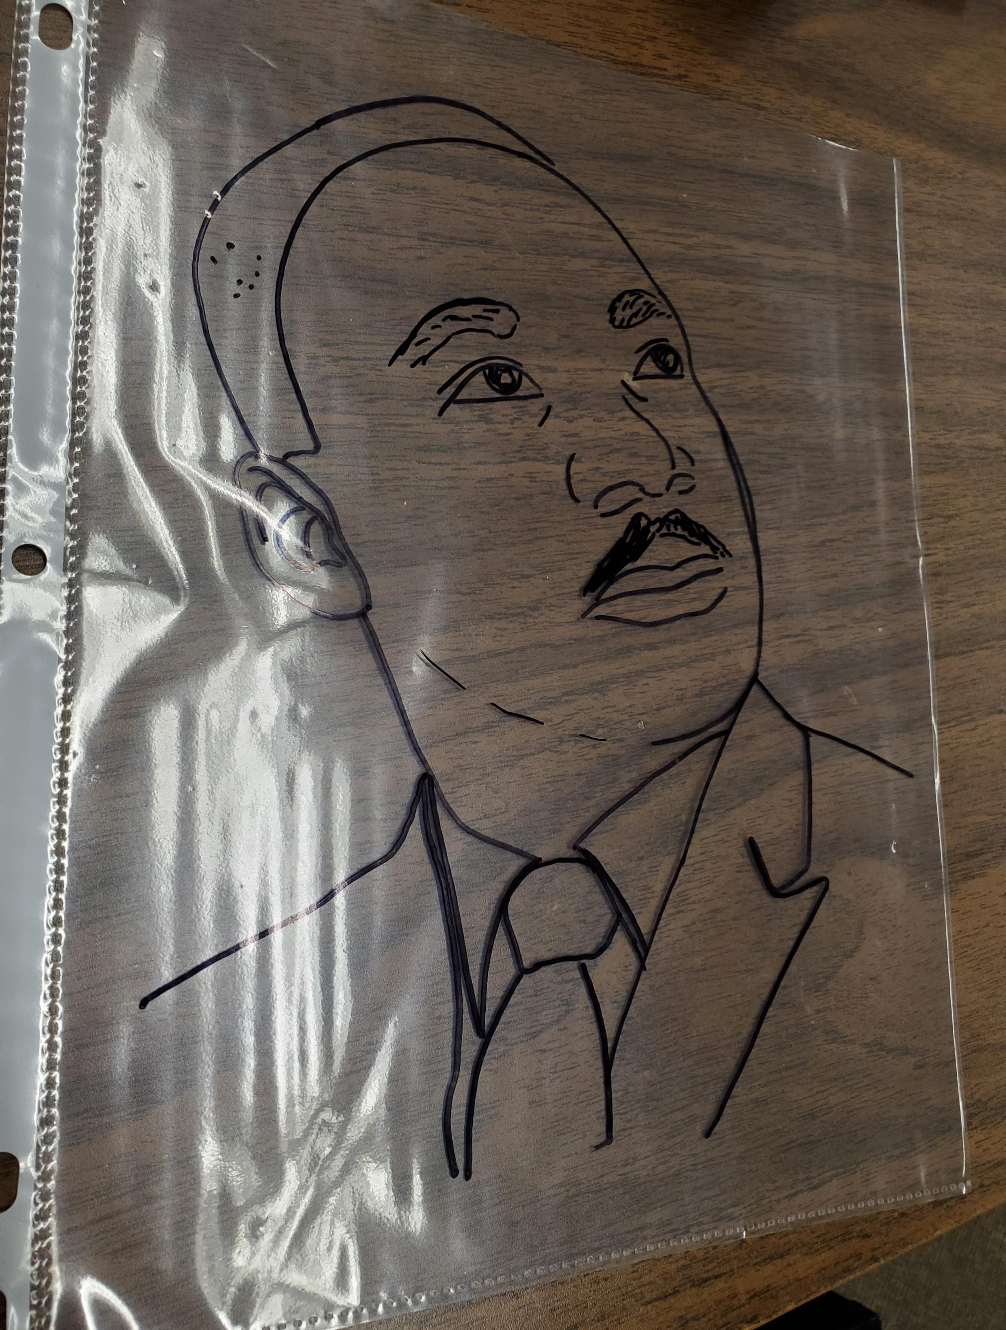
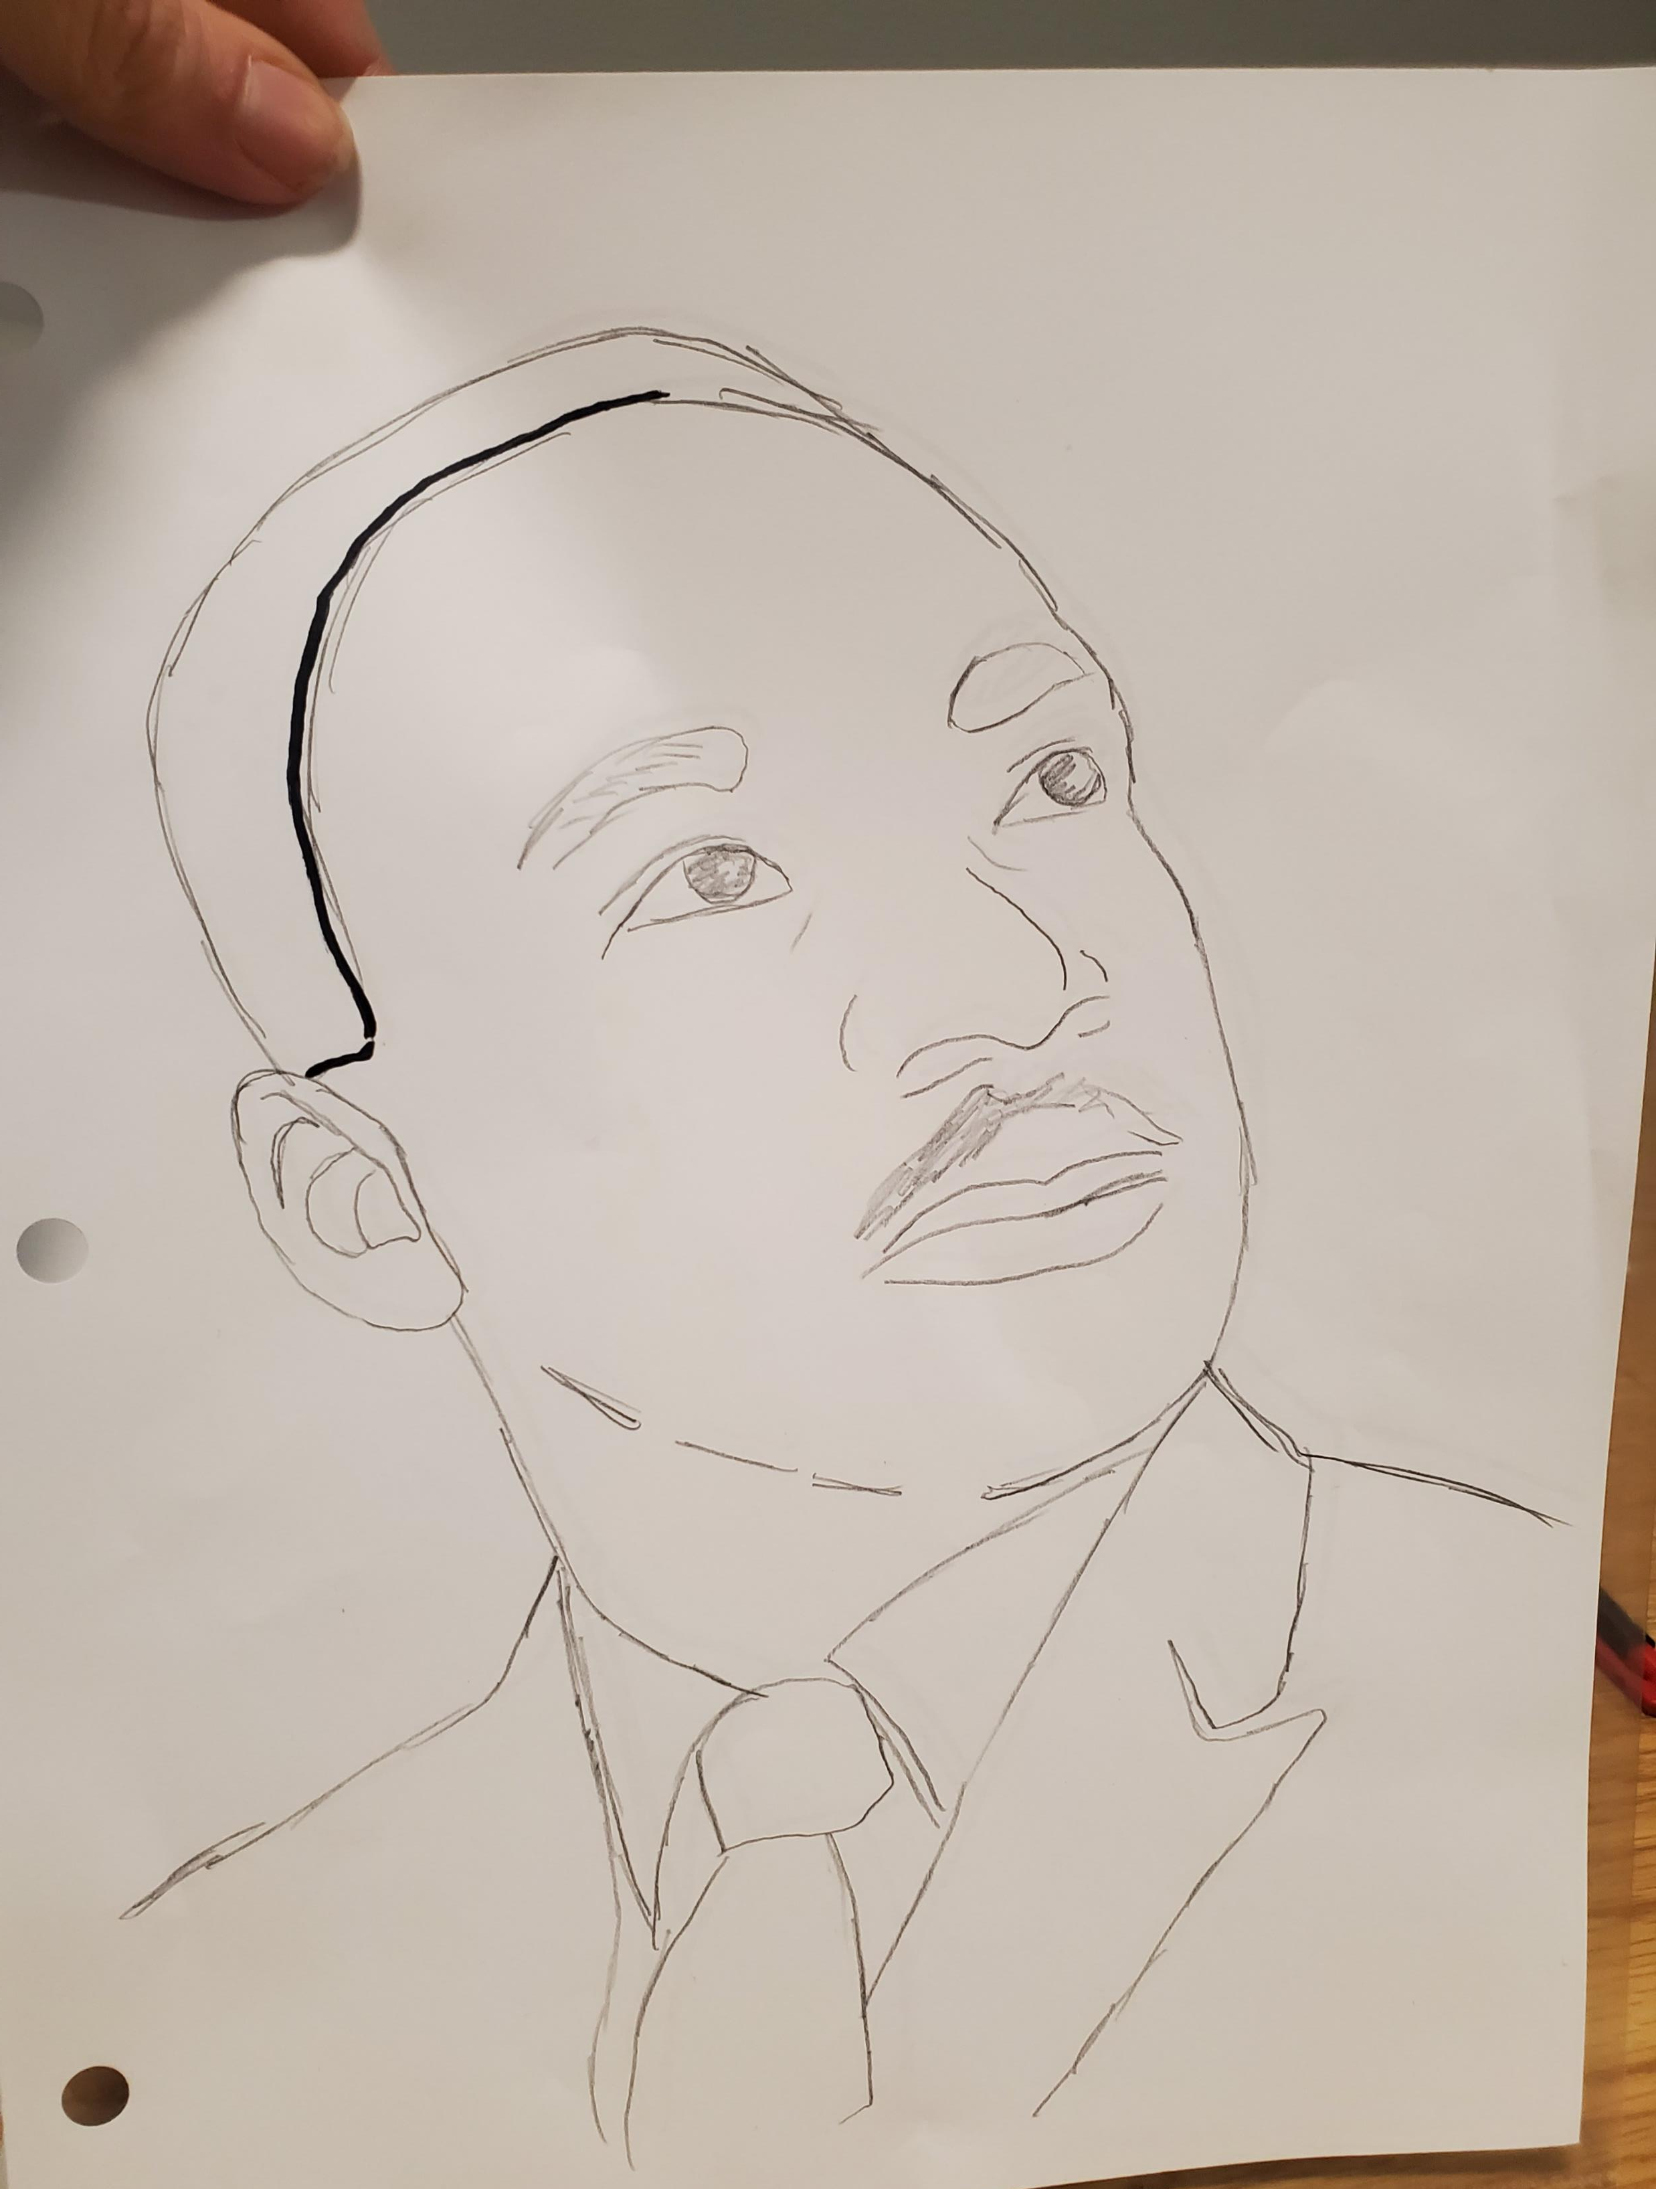
Trace… AGAIN
Get a white piece of paper
Go to a window and trace the lines you made on your page protector onto your white paper

Slide 12
Finishing touches
Add final details to your portrait to make it look more neat and finished
If you feel confident, you could add shading with pencils or paint

Slide 13
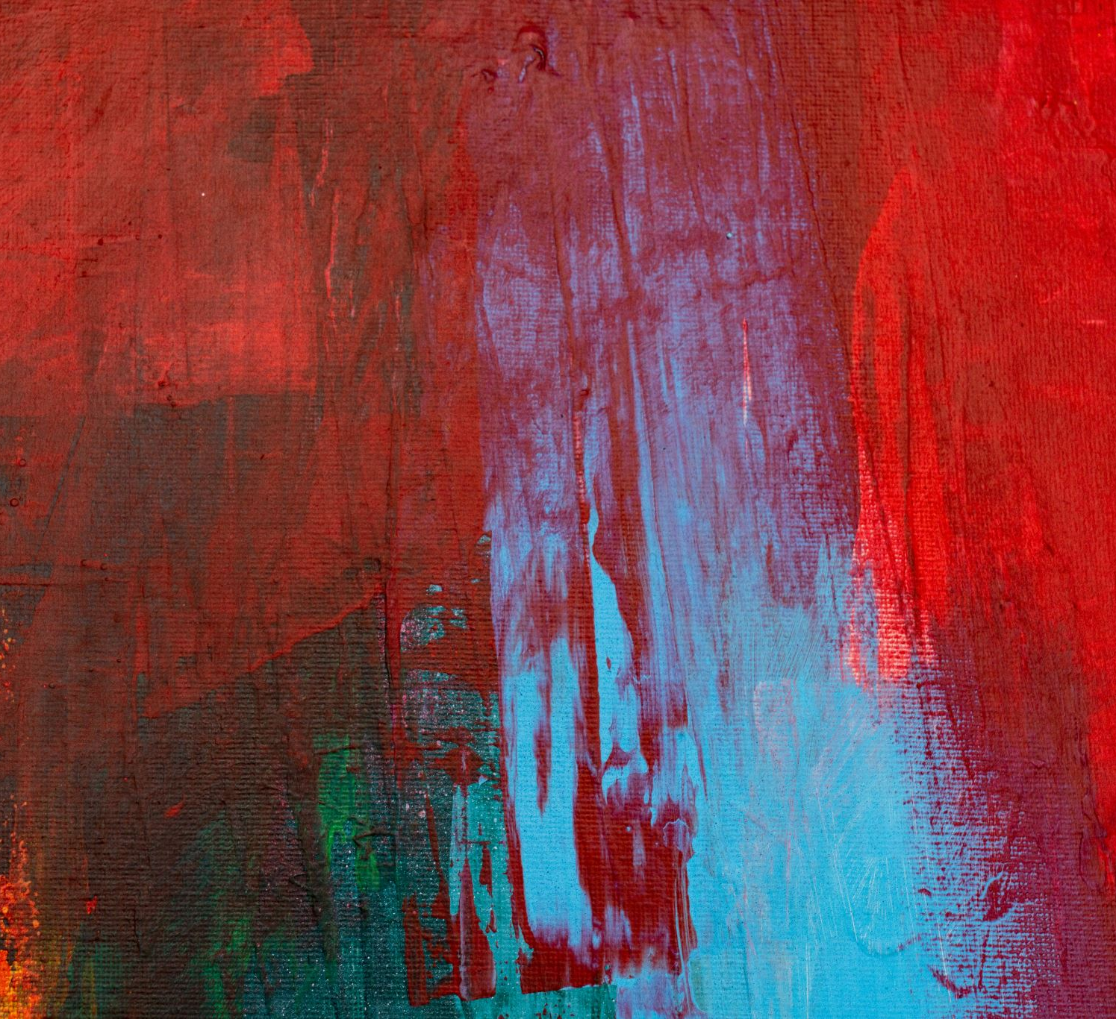
Step 2 – Create the Background on Canvas
Think about the person you researched
Where are they from?
What is their cultural background?
What struggles did they face?
What impact did they make on the world?
What are some colours, images, or patterns that represent them?

Slide 14
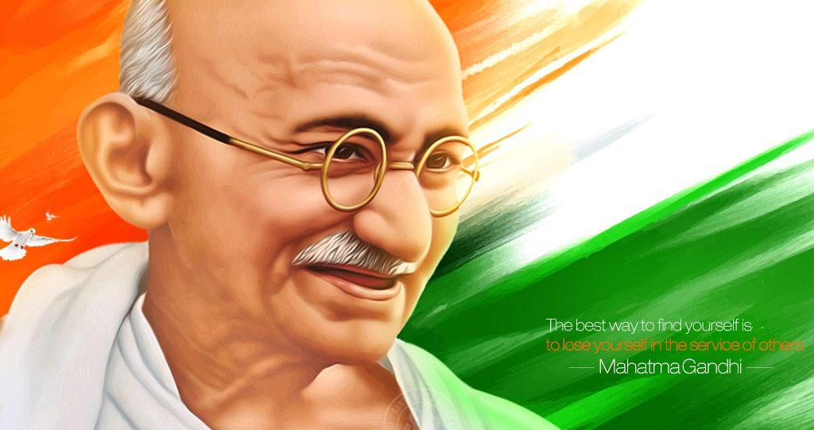
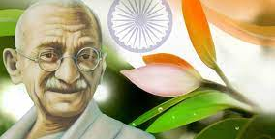
tips
Keep it simple and bold!
Think about the MEANING of the colours you choose

Slide 15
Rough Draft
In your sketchbook, create at least 3 different ideas for a background

Slide 16
Canvas – first step
Glue down your portrait with mod podge
OR
Paint the entire background in one solid colour
OR
Draw a very light sketch of your background in pencil

Slide 17
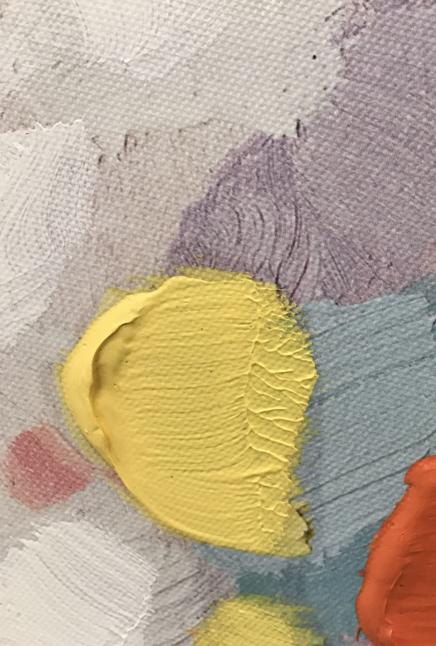
Canvas – next step
Paint everything, let it dry, then glue on your portrait
OR
Paint everything after your portrait has been glued and dried
Tips:
Acrylic paint dries quickly! You can easily paint in layers. Paint a colour, let it dry, paint another.
You can use CHALK to sketch over dried paint – it wipes away easily!

